Slide 1
Session 4.2 JavaScript Operators and Loops

Slide 2
Contents
JavaScript Operators
JavaScript Conditions (If….Else)
For Loop in JavaScript
JavaScript While Loop

Slide 3
JavaScript Arithmetic Operators
Operator | Description | Example
+ | Addition | x=y+2
- | Subtraction | x=y-2
* | Multiplication | x=y*2
/ | Division | x=y/2
% | Modulus(division remainder) | x=y%2
++ | Increment | x=++y
- - | Decrement | x=y- -

Slide 4
JavaScript Assignment Operators
Operator | Example | Same As
= | x=y
+= | x+=y | x=x+y
- = | x-=y | x=x-y
* = | x*=y | x=x*y
/= | x/=y | x=x/y
%= | x%=y | x=x%y

Slide 5
JavaScript Operator Basics
To add two or more string variables together, use the + operator.
The assignment operator = is used to assign values to JavaScript variables.
If you add a number and a string, the result will be a string!

Slide 6
JavaScript If….Else
if statement- use this statement to execute some code only if a specified condition is true
if…else statement – use this statement to execute some code if the condition is true and another code if the condition is false
if…else if…else statement – use this statement to select one of many blocks of code to be executed.

Slide 7
If…Else Syntax
if (condition1)
{
code to be executed if condition1 is true
}
else if (condition2)
{
code to be executed if condition2 is true
}
else
{
code to be executed if neither condition1 nor condition2 is true
}

Slide 8
Conditional Operators
The conditional operator is the only JavaScript operator that takes three operands. The operator can have one of two values based on a condition.
Syntax:
var variable_name=(condition)?value1:value2
voteable =(age<18)?"Too young":"Old enough";

Slide 9
+ Operator used on Strings
The + operator can be used to add string variables or text values together or it can be used to add a string to a number.
Example
x=5+5;
y="5"+5;
z="Hello"+5;
The result of x, y and z will be:
10
55
Hello5

Slide 10
test() function in JavaScript
The test() method tests for a match in a string. This method returns true if it finds a match, otherwise it returns false.
Syntax
RegExpObject.test(string)
var str="Hello world!";
//look for "Hello"
var patt=/Hello/g;
var result=patt.test(str);
document.write("Returned value: " + result); //true
Notes:
A regular expression is a sequence of characters that forms a search pattern.
The search pattern can be used for text search and text replace operations.
What Is a Regular Expression?
A regular expression is a sequence of characters that forms a search pattern.
When you search for data in a text, you can use this search pattern to describe what you are searching for.
A regular expression can be a single character, or a more complicated pattern.
Regular expressions can be used to perform all types of text search and text replace operations.
Syntax
/pattern/modifiers;
The "g" modifier specifies a global match.
A global match finds all matches (compared to only the first).
The "i" modifier specifies a case-insenitive match.
The "m" modifier specifies a multiline match.
It only affects the behavior of start ^ and end $.
^ specifies a match at the start of a string.
$ specifies a match at the end of a string.
With the "m" set, ^ and $ also match at the beginning and end of each line.

Slide 11
Expressions in JavaScript
An object creation expression creates a new object and invokes a function (called a constructor) to initialize the properties of that object.
Syntax:
new Object()
new Point(2,3)
If no arguments are passed to the constructor function in an object creation expression, the empty pair of parentheses can be omitted:
Syntax:
new Object
new Date

Slide 12
Expressions in JavaScript
An invocation expression is JavaScript’s syntax for calling (or executing) a function or method.
It starts with a function expression that identifies the function to be called.
The function expression is followed by an open parenthesis, a comma-separated list of zero or more argument expressions, and a close parenthesis.
f(0) // f is the function expression; 0 is the argument expression.
Math.max(x,y,z) // Math.max is the function; x, y and z are the arguments.
a.sort() // a.sort is the function; there are no arguments.

Slide 13
Expressions in JavaScript
The simplest expressions, known as primary expressions, are those that stand alone—they do not include any simpler expressions. Primary expressions in JavaScript are constant or literal values, certain language keywords, and variable references.
1.23 // A number literal
"hello" // A string literal
/pattern/ // A regular expression literal
true // Evalutes to the boolean true value
false // Evaluates to the boolean false value
null // Evaluates to the null value
this // Evaluates to the "current" object

Slide 14
‘in’ operator in JavaScript
The ‘in’ operator is a special kind of operator used in JavaScript. ‘in’ operator returns true if the specified property is in the specified object.
Syntax:
propNameOrNumber in objectName
where propNameOrNumber is a string or numeric expression representing a property name or array index, and objectName is the name of an object.

Slide 15
‘in’ operator in JavaScript
Arrays
var trees = new Array("redwood", "bay", "cedar", "oak", "maple");
0 in trees; // returns true
3 in trees; // returns true
6 in trees; // returns false
"bay" in trees; // returns false (you must specify the index number, not the value at that index)
"length" in trees; // returns true (length is an Array property)

Slide 16
‘in’ operator in JavaScript
Predefined objects
"PI" in Math; // returns true
var myString = new String("coral");
"length" in myString; // returns true
Custom objects
var mycar = {make: "Honda", model: "Accord", year: 1998};
"make" in mycar; // returns true
"model" in mycar; // returns true

Slide 17
‘===’ operator in JavaScript
Determining whether two variables are equivalent is one of the most important operations in programming.
Double equals
If (99 == "99"){ document.write(“true”);}
if (x == y) {
// do something here
}
Triple-equals operator, also called “strict equals” or “identically equal”
if(99 === "99"){document.write(“false”);}
if (x === y) {
// do something here
}
Notes:
If the comparison in double-equals being made is between two different “types” of values, type coercion will occur. The triple-equals operator never does type coercion.

Slide 18
delete operator in JavaScript
The delete operator deletes an object, an object's property, or an element at a specified index in an array.
delete objectName;
delete objectName.property;
delete objectName[index];
delete property; // legal only within a with statement
where objectName is the name of an object, property is an existing property, and index is an integer representing the location of an element in an array.

Slide 19
delete operator in JavaScript
x = 42;
var y = 43;
myobj = new Number();
myobj.h = 4; // create property h
delete x; // returns true (can delete if declared implicitly)
delete y; // returns false (cannot delete if declared with var)
delete Math.PI;//returns false (cannot delete predefined properties)
delete myobj.h; // returns true (can delete user-defined properties)
delete myobj; // returns true (can delete if declared implicitly)

Slide 20
delete operator in JavaScript
Deleting array elements
When you delete an array element, the array length is not affected. For example, if you delete a[3], a[4] is still a[4] and a[3] is undefined.
The trees[3] is removed with delete. However, trees[3] is still addressable and returns undefined.
var trees = new Array("redwood", "bay", "cedar", "oak", "maple");
delete trees[3];
if (3 in trees) {
// this does not get executed
}
Notes:
When the delete operator removes an array element, that element is no longer in the array. In the following example, trees[3] is removed with delete. However, trees[3] is still addressable and returns undefined.

Slide 21
delete operator in JavaScript
If you want an array element to exist but have an undefined value, use the undefined keyword instead of the delete operator.
var trees = new Array("redwood", "bay", "cedar", "oak", "maple");
trees[3] = undefined;
if (3 in trees) {
// this gets executed
}
Notes:
When the delete operator removes an array element, that element is no longer in the array. In the following example, trees[3] is removed with delete. However, trees[3] is still addressable and returns undefined.

Slide 22
typeof operator in JavaScript
The typeof operator is used in either of the following ways:
typeof operand
typeof (operand)
The typeof operator returns a string indicating the type of the unevaluated operand.
Operand is the string, variable, keyword, or object for which the type is to be returned.
The parentheses are optional.

Slide 23
typeof operator in JavaScript
Example
var myFun = new function("5 + 2");
var shape = "round";
var size = 1;
var today = new Date();
The typeof operator returns the results:
typeof myFun; // returns "function"
typeof shape; // returns "string"
typeof size; // returns "number"
typeof today; // returns "object"
typeof dontExist; // returns "undefined"

Slide 24
Logical Operators
Logical operators are typically used with Boolean (logical) values; when they are, they return a Boolean value.
Operator | Usage | Description
Logical AND (&&) | expr1 && expr2 | Returns expr1 if it can be converted to false; otherwise, returns expr2. Thus, when used with Boolean values, && returns true if both operands are true; otherwise, returns false.
Logical OR (||) | expr1 || expr2 | Returns expr1 if it can be converted to true; otherwise, returns expr2. Thus, when used with Boolean values, || returns true if either operand is true; if both are false, returns false.
Logical NOT (!) | !expr | Returns false if its single operand can be converted to true; otherwise, returns true.

Slide 25
Logical Operators
As logical expressions are evaluated left to right, they are tested for possible "short-circuit" evaluation using the following rules:
False && anything is short-circuit evaluated to false.
True || anything is short-circuit evaluated to true.
function shortCircuitEvaluation () {
doSomething() || doSomethingElse()
}
function equivalentEvaluation() {
var flag = doSomething();
if (!flag) {
doSomethingElse ();
} }

Slide 26
Accessing HTML Elements (Nodes)
Accessing an HTML element is the same as accessing a Node.
getElementById() method
The getElementById() method returns the element with the specified ID:
Syntax:
node.getElementById("id");
Gets the element with id="intro":
document.getElementById("intro");

Slide 27
Accessing HTML Elements (Nodes)
getElementsByTagName() method
The getElementsByTagName() returns all elements with a specified tag name.
Syntax
node.getElementsByTagName("tagname");
Returns a list of all <p> elements in the document:
document.getElementsByTagName("p");
Returns a list of all <p> elements that are descendants (children, grandchildren, etc.) of the element with id="main":
document.getElementById("main").getElementsByTagName("p");

Slide 28
Accessing HTML Elements (Nodes)
getElementsByClassName() method
If you want to find all HTML elements with the same class name.
Example
document.getElementsByClassName("intro");

Slide 29
Loops in JavaScript
JavaScript supports different kinds of loops:
for- loops through a block of code a number of times
for/in-loops through the properties of an object
while-loops through a block of code while a specified condition is true
do/while – also loops

Slide 30
for loop in JavaScript
for(statement 1; statement 2; statement 3)
{
the code block to be executed
}
Statement 1 is executed before the loop (the code block) starts.
Statement 2 defines the condition for running the loop (the code block)
Statement 3 is executed each time after the loop (the code block) has been executed.

Slide 31
for/In Loop in JavaScript
var person = {fname: “John”, lname: “Doe, age: 25};
for (x in person)
{
txt =txt + person[x];
}
Notes:
for in return key

Slide 32
while loop in JavaScript
The while loop loops through a block of code as long as a specified condition is true
while(condition)
{
code block to be executed
}

Slide 33
do/while in JavaScript
do
{
code block to be executed
}
while(condition);

Slide 34
Use JavaScript to write HTML
To access an HTML element from JavaScript, you can use the document.getElementById(id) method.
<script>
document.getElementById(“demo”).innerHTML= “My First JavaScript”
</script>

Slide 35
Adding HTML using JavaScript
Used to give output or errors on Web requests
<script>
document.write (“<p> My First JavaScript</p>”);
</script>

Slide 36
Handling Events in JavaScript
Creating a POP-UP alert
Handling the onclick event
Handling the onmouseover event
Creating a JavaScript Clock on page.

Slide 37
JavaScript Pop-Up Boxes
alert("Write some text here")
An alert box is often used if you want to make sure information comes through to the user.
When an alert box pops up, the user will have to click "OK" to proceed.
Example:
window.alert("sometext");

Slide 38
JavaScript Pop-Up Boxes
Confirm Box
A confirm box is often used if you want the user to verify or accept something.
When a confirm box pops up, the user will have to click either "OK" or "Cancel" to proceed.
If the user clicks "OK", the box returns true. If the user clicks "Cancel", the box returns false.
Syntax:
window.confirm("sometext");
The window.confirm() method can be written without the window prefix.

Slide 39
JavaScript Pop-Up Boxes
Prompt Box
A prompt box is often used if you want the user to input a value before entering a page.
When a prompt box pops up, the user will have to click either "OK" or "Cancel" to proceed after entering an input value.
If the user clicks "OK" the box returns the input value. If the user clicks "Cancel" the box returns null.
Syntax
window.prompt("sometext","defaultvalue");
The window.prompt() method can be written without the window prefix.

Slide 40
onmouseover event in JavaScript
The onmouseover event executes a JavaScript when moving the mouse pointer onto an image.
<img onmouseover="bigImg (this)" src="smiley.gif alt="Smiley">
The onmouseover event occurs when the pointer is moved onto an element.
Syntax
In HTML:
<element onmouseover="SomeJavaScriptCode">
In JavaScript:
object.onmouseover =function () {SomeJavaScriptCode};

Slide 41
oncontextmenu event in JavaScript
oncontextmenu event is a complex events which is triggered when a right-button mouse click over an element.
Complex events
Also browser provides the following more complex events for convenience:
click :Triggered by a mouse click: mousedown and then mouseup over an element
contextmenu: Triggered by a right-button mouse click over an element.
dblclick :Triggered by two clicks within a short time over an element
<input type="button" oncontextmenu="alert ('Custom menu'); return false" value="Right-click me"/>

Slide 42
oncontextmenu event in JavaScript
<script language="JavaScript">
function function2() {
alert("This image is copyrighted")
}
</script>
<body oncontextmenu="function2()">
<p>Right click in the image.</p>
<img oncontextmenu="function2()" src="images/browser.png"
alt="" width="99" height="76">
</body>

Slide 43
onblur event in JavaScript
This event executes a JavaScript when a user leaves an input field:
<input type="text" onblur="myFunction ()">
In JavaScript:
object.onblur = function () {SomeJavaScriptCode};
The onblur event occurs when an object loses focus, onblur is most often used with form validation code (e.g. when the user leaves a form field).
The onblur event is the opposite of the onfocus event which is triggered when an element gets focus, onfocus event is most often used with <input>, <select>, and <a> tags.

Slide 44
onblur event in JavaScript
<head>
<script>
function myFunction()
{ var x=document.getElementById("fname");
x.value=x.value.toUpperCase();
}
</script>
</head>
<body>
Enter your name: <input type="text" id="fname“ onblur="myFunction()">
</body>

Slide 45
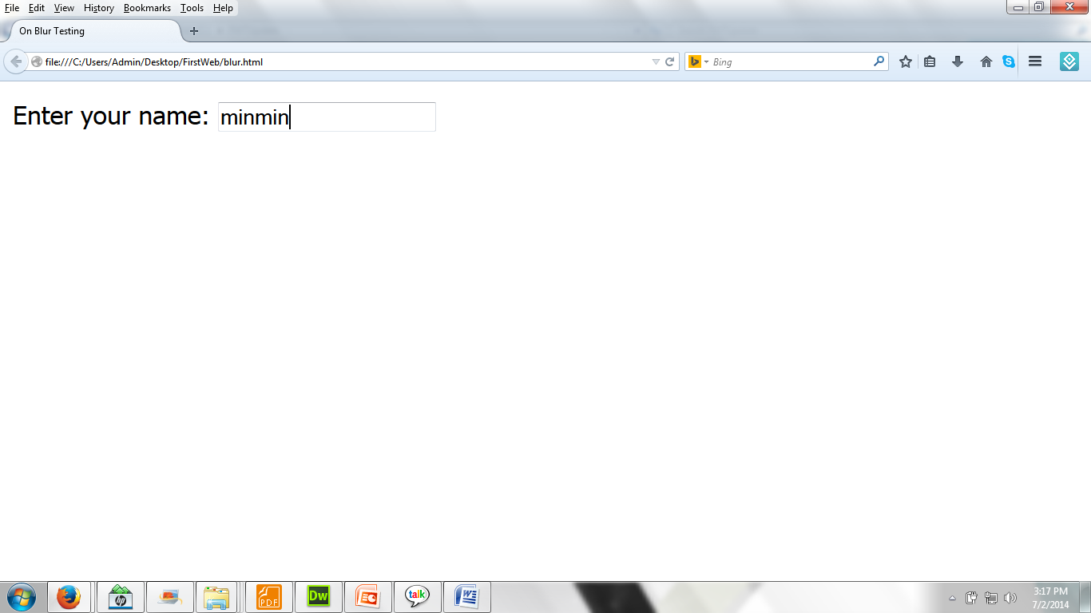
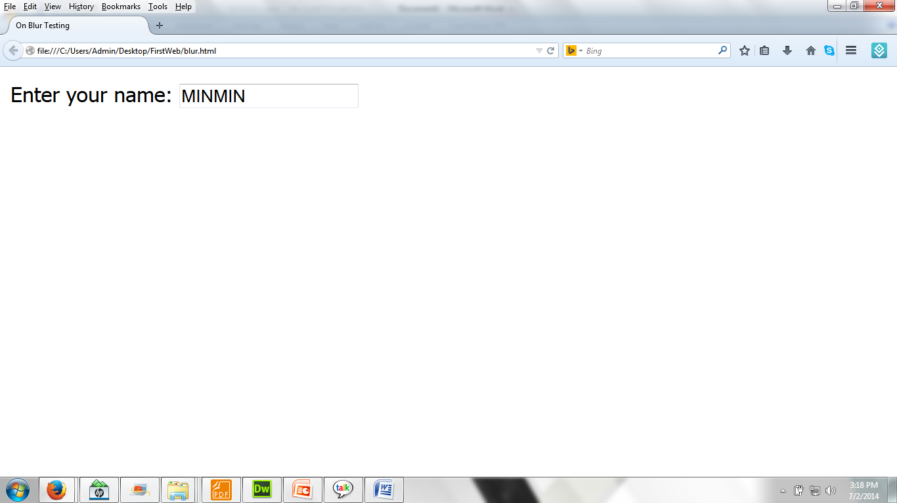
onblur event in JavaScript

Slide 46
window.captureEvents in JavaScript
window.captureEvents method registers the window to capture all events of the specified type.
Syntax:
window.captureEvents (eventType)
Event.ABORT, Event.BLUR, Event.CLICK, Event.CHANGE, Event.DBLCLICK, Event.DRAGDDROP, Event.ERROR, Event.FOCUS, Event.KEYDOWN, Event.KEYPRESS, Event.KEYUP, Event.LOAD, Event.MOUSEDOWN, Event.MOUSEMOVE, Event.MOUSEOUT, Event.MOUSEOVER, Event.MOUSEUP, Event.MOVE, Event.RESET, Event.RESIZE, Event.SELECT, Event.SUBMIT, Event.UNLOAD.

Slide 47
window.captureEvents in JavaScript
<script language="JavaScript1.2">
var counter = 0;
window.captureEvents(Event.CLICK)
window.onclick = myClickHandler;
function myClickHandler(){
window.document.myForm.myText.handleEvent;
}
function changeText(){
document.myForm.myText.value = counter++;
}
</script>

Slide 48
window.captureEvents in JavaScript
<body>
<form name="myForm">
<input type=TEXT size=2 value="" name="myText" onClick='changeText()'>
</form>
</body>

Slide 49
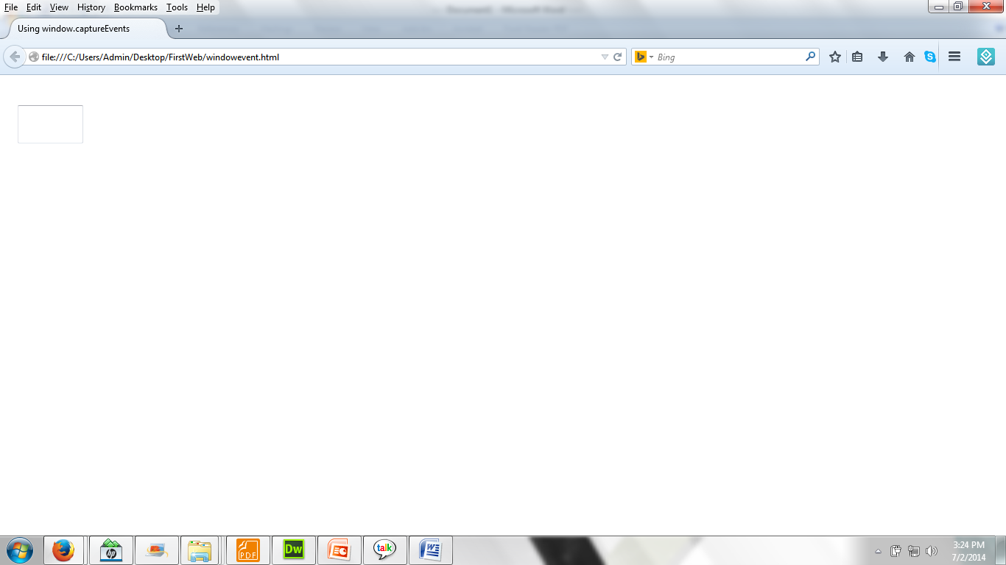
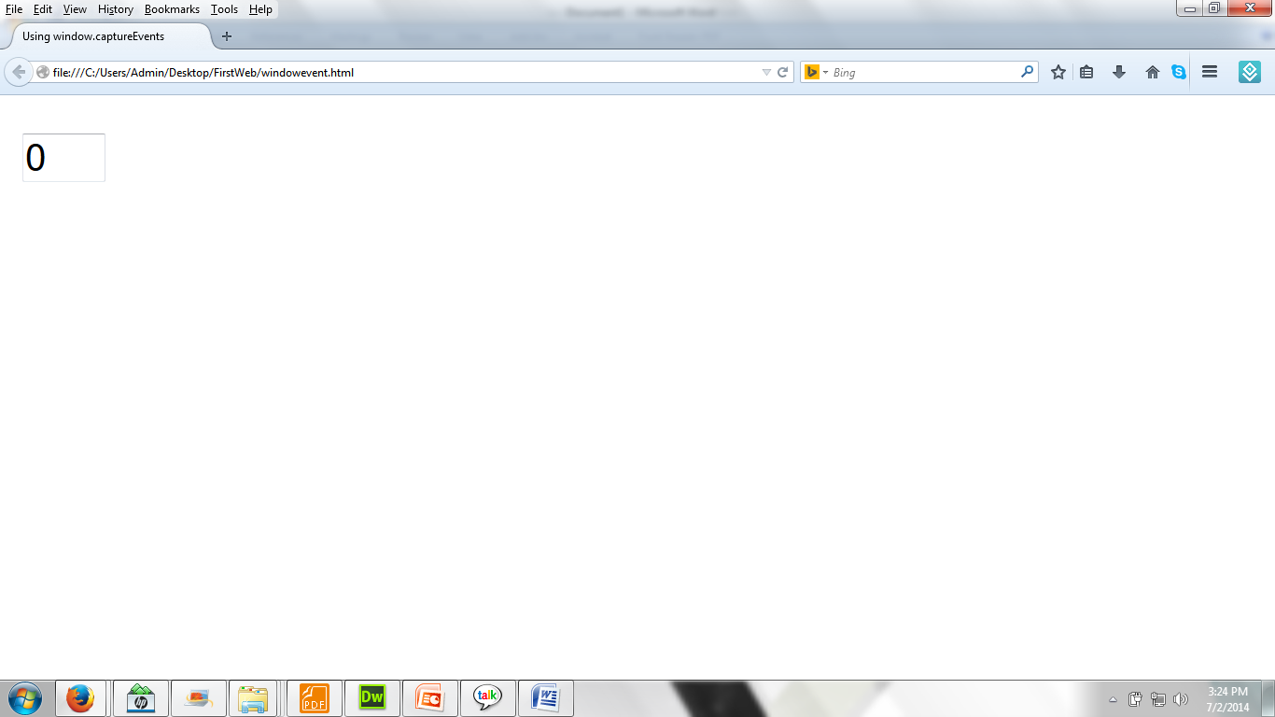
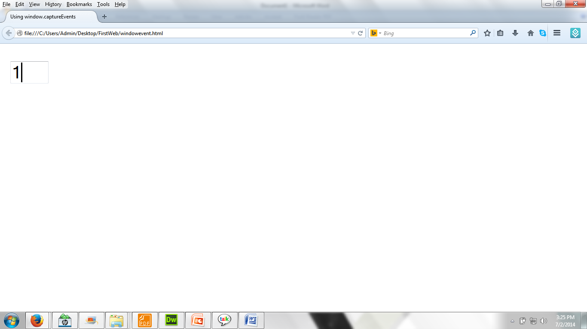
window.captureEvents in JavaScript

Slide 50
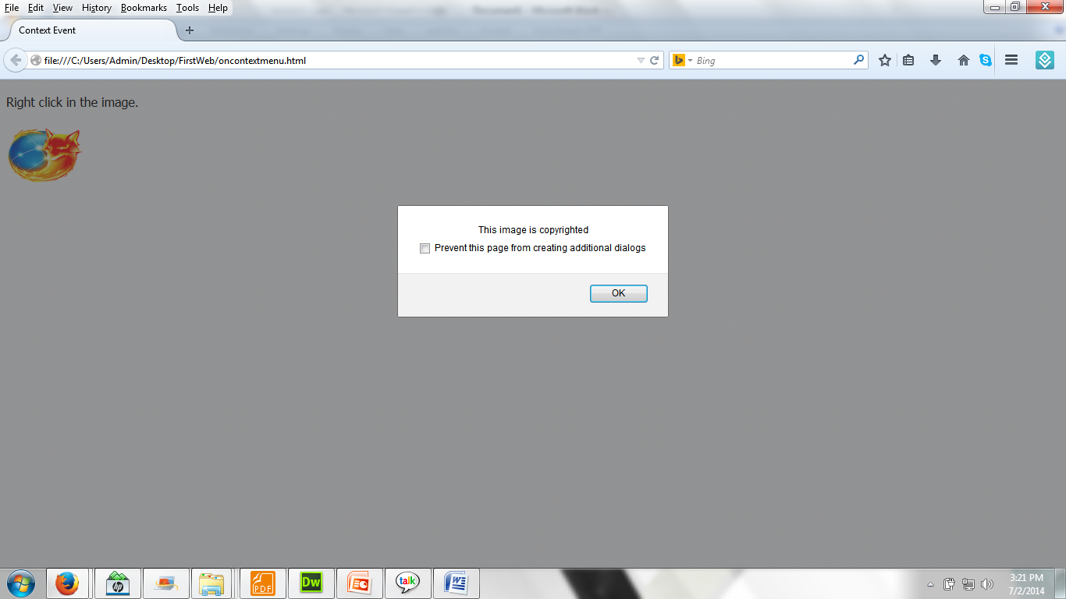
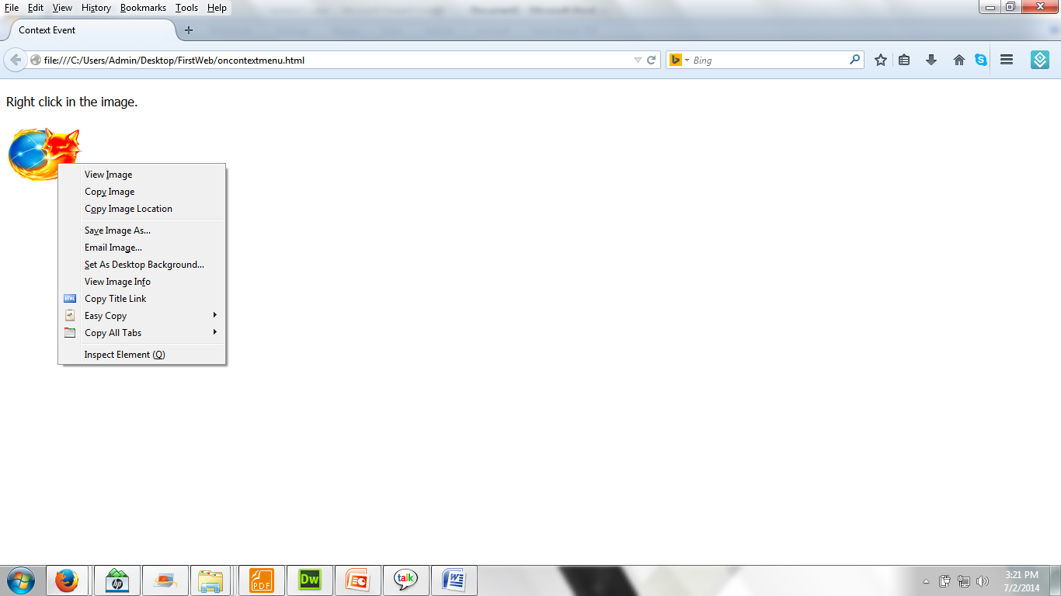
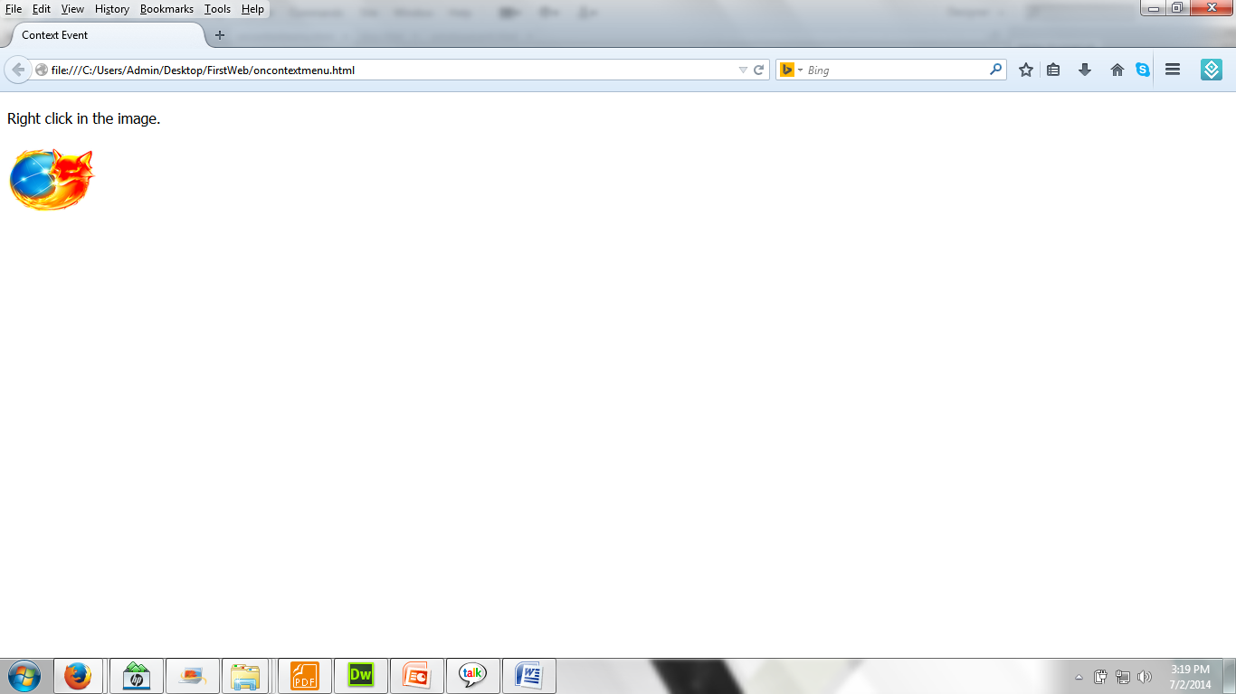

window.captureEvents (demo)

Slide 51
Thank you!

